Slide 1
Chapter 07 POINTER
Dr. Le Thanh Sach

Slide 2
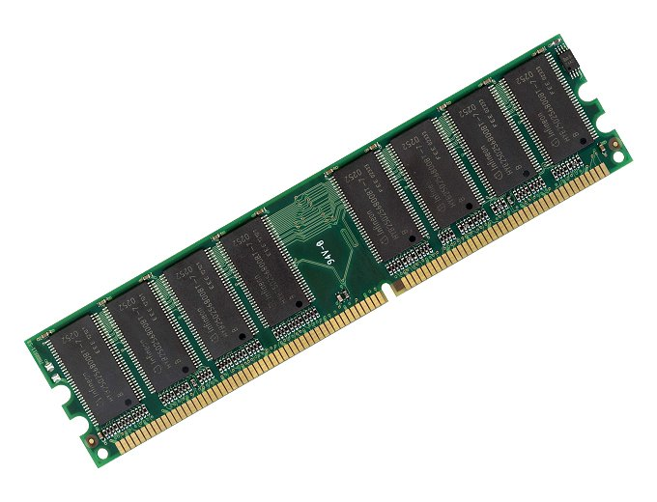

Slide 3
Content
Memory layout
Uses of pointer
Model of pointer
& Operator
Declare a pointer
* Operator
Operations on pointer
Pointer and array
Dynamic memory allocation
Pointers and structures, -> operator
Advanced topics with pointers
Order of evaluation * và ++, --
Pointer and const
Pointer to pointer
Void pointer

Slide 4
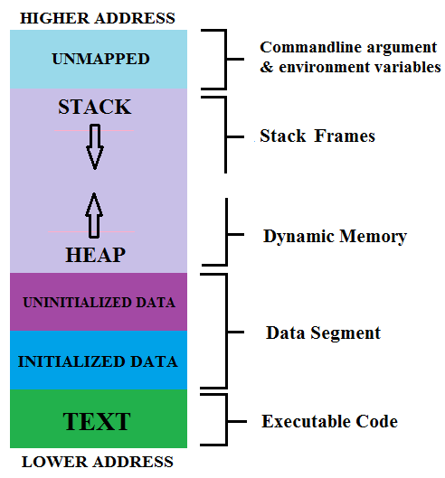
Memory layout
When the program is put into the memory to execute, the system organizes the memory like the next diagram
(Source: http://proprogramming.org/)

Slide 5
Memory layout
“text” area
Contains executable code of the program
This area is read-only
This area can be shared in case the program is executed frequently
(Nguồn: http://proprogramming.org/)

Slide 6
Memory layout
“Data” Area
include:
Initialized data (by programmer)
Uninitialized data (by programmer)
(Source: http://proprogramming.org/)

Slide 7
Memory layout
“Data” area
Include:
Initialized data (by programmer)
Global variable
Static variable
This area consists of two sub-areas:
Read-only
Example: String constant
Read/Write
Non-constant static and global variables
(Source: http://proprogramming.org/)

Slide 8
Memory layout
“Data” area
Include:
Initialized data
Uninitialized data by programmer
Global variable
Static variable
The system assign 0 (number) to variables that were not explicitly initialized by programmer
(Nguồn: http://proprogramming.org/)

Slide 9
Memory layout
“HEAP” area
Contains memory that is allocated dynamically by the programmer
Is related to the pointer type discussed in this chapter
(source: http://proprogramming.org/)

Slide 10
Memory layout
“STACK” area
Include:
Variables which were declared in the program
Information of each function call
(Nguồn: http://chortle.ccsu.edu/)
(Nguồn: http://proprogramming.org/)

Slide 11
Uses of pointer
Array in C++
Must know the number of elements at the time of writing the code
Therefore, it is necessary to declare a large number of memory cells. However, at some point, the program may use a lot less → wasteful
Question: Is it possible to use an array with the number of elements that can only be known when the program is running?
=> We need pointer

Slide 12
Uses of pointer
Array in C++
When adding and removing elements on the array
=> Need to move many elements to the right and to the left → Time consuming
Question: Is there any way to organize the data that helps to manage the above elements quickly?
=> Use linked list
=> We need pointer

Slide 13
Model of pointer
Variable a: Is a variable of any kind
Started memory cell of a has the address:
(example) 0x1234 FFFF
0x1234 FFFF
Variable p: Is a pointer
Contains the address of the variable x,
It means that the value of p is 0x1234 FFFF

Slide 14
Model of pointer
Variable a: Is a variable of any kind
Started memory cell of a has the address:
(example) 0x1234 FFFF
Variable p: Is a pointer
Contains the address of the variable x,
It means that the value of p is 0x1234 FFFF
The pointer is illustrated by an arrow from variable p Point to the memory cell of variable x

Slide 15
& Operator
The pointer stores the address of another memory cell (variable) ➔ How to get the address of a variable or memory cell to assign a pointer variable

Slide 16
& Operator
The pointer stores the address of another memory cell (variable) ➔ How to get the address of a variable or memory cell to assign to a pointer variable
Method 1: Use the & operator to get the address of an existing variable
Method 2: Request dynamic memory allocation (later)

Slide 17
& Operator
The operator & returns the address of a variable
Example
#include <iostream>
using namespace std;
int main(){
int a = 100;
cout << a << endl;
cout << &a << endl;
system("pause");
return 0;
}
Print out the value of a
Print out the address of a

Slide 18
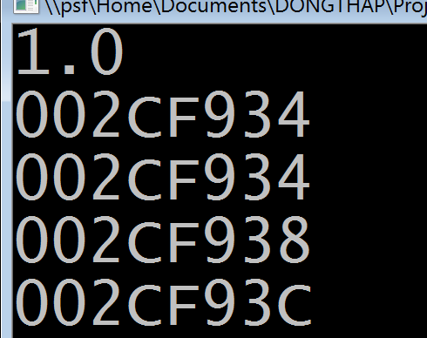
& Operator
The operator & returns the address of a variable
Example
#include <iostream>
using namespace std;
typedef struct sPoint3D{float x, y, z;} Point3D;
int main(){
Point3D p1 = {1.0f, 2.0f, 3.0f};
cout << p1.x << endl;
cout << &p1 << endl;
cout << &p1.x << endl;
cout << &p1.y << endl;
cout << &p1.z << endl;
system("pause");
return 0;
}
Print out the value of p1.x
Print out the address of p1
Print out the address of p1.x
Print out the address of p1.y
Print out the address of p1.z

Slide 19
Pointer declaration Syntax
<Type name> * <Variable name>;
<Type name> * <Name of variable a> = 0;
<Type name> * <Name of variable a> =
&<Name of variable b>;
<Name of variable b>: Muse have type <Type name>, or have type that can be casted to <Type name>
0: Constant, is called NULL

Slide 20
Pointer declaration Syntax
a: is an Integer
p1: pointer to Integer, unknown value
p2: pointer to Integer, the value is NULL
p3: pointer to Integer, the value is the address of the memory cell of a
int a;
int *p1;
int *p2 = 0;
int *p3 = &a;
double d;
double *pd1;
double *pd2 = 0;
double *pd3 = &d;
float f;
float *pf1;
float *pf2 = 0;
float *pf3 = &d;
Point3D p1 = {1.0f, 2.0f, 3.0f};
Point3D *pp1;
Point3D *pp2 = 0;
Point3D *pp3 = &p1;
f: is float
pf1: pointer to float, unknown value
pf2: pointer to float, the value is NULL
pf3: pointer to float, the value is the address of the memory cell of f

Slide 21
* Operator
The operator * get the reference value at an address
Operator & get address of variable

Slide 22
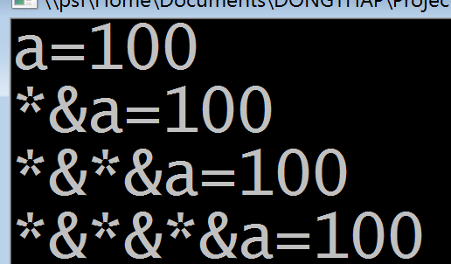
* Operator
#include <iostream>
using namespace std;
int main(){
int a = 100;
cout << "a=" << a << endl;
cout << "*&a=" << *&a << endl;
cout << "*&*&a=", *&*&a << endl;
cout << "*&*&*&a=%d\n" <<*&*&*&a << endl;
system("pause");
return 0;
}

Slide 23
Operations on the pointer
Increase and Decrease : ++, --
Addition and subtraction : +, -
Addition and subtraction combined with assignment : +=, -=
Comparation: ==, !=
Let p be a pointer of type T: T *p;
Addition and Subtraction: Make pointer p increase or decrease a multiple of size of type T.

Slide 24
Pointer and Array
Pointer and array have many similarities
Pointer and array : Keep address of memory cell
Pointer: Keeps the address of a certain memory cell (of another variable, of dynamic memory)
Array: Keep the address of the first element
=> Can assign array to pointer
However, assigning pointer to array is not allowed

Slide 25
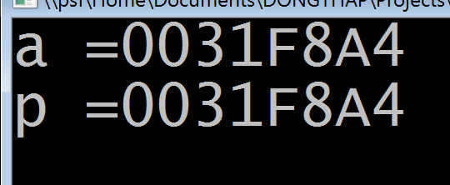
Pointer and Array
#include <iostream>
using namespace std;
int main(){
int a[5];
int *p = a;
cout << "a =" << a << endl;
cout << "p ="<< p << endl;
system("pause");
return 0;
}
Array pointer can be assigned to pointer
=>
A and p have the same address: The address of the first cell on the array

Slide 26
Pointer and array
Pointers and arrays have many similarities
Same way to access memory cells
Use [ ] operator
Use * and + operator
int a[5];
int *p = a;
int id = 2;
a[id] = 100;
p[id] = 100;
*(a + id) = 100;
*(p + id) = 100;
Same

Slide 27
Pointer and array
Pointers and arrays also have differences
Array: The elements of the array are on the STACK of the program
Pointer: The elements that the pointer points to can be stored on STACK or HEAP

Slide 28
Dynamic memory allocation
Help programmers create dynamic arrays. No need to determine the number of elements of dynamic array at compile time as static array.
Dynamic arrays will be allocated on HEAP
When you use dynamic memory allocation
You MUST release memory after usage

Slide 29
Dynamic memory allocation
Allocate dynamic memory
new
Release dynamic memory
delete

Slide 30
Dynamic memory allocation new
#include <iostream>
typedef struct sPoint3D{float x, y, z;} Point3D;
int main(){
int *p1;
float *p2;
Point3D *p3;
int num = 100;
p1 = new int[num];
p2 = new float[num];
p3 = new Point3D();
delete []p1; delete []p2; delete []p3;
return 0;
}
Pointer variables
Allocate memory
Release memory

Slide 31
Dynamic memory allocation new
p1 = new int[num];
num: number of elements
int: data type of each element
➔ int[num]: allocate num elements with int data type

Slide 32
Dynamic memory allocation new
#include <iostream>
using namespace std;
int main(){
int num = 100;
int *p1 = new int[num];
if (p1 == NULL){
cout << "Can not allocate!" << endl;
exit(1);
}
else{
// Your work goes here…
delete(p1);
}
return 0;
}

Slide 33
Dynamic memory allocation new
int *p1 = new int[num];
If (p1 == NULL){ ...} else { ...}
Operator new returns a NULL pointer when it fails.
At that time, memory cannot be used!
Therefore, ALWAYS check if the new operator returns NULL

Slide 34
Dynamic memory allocation Example
Declare pointer variables with data types + allocate dynamic memory
typedef struct{
float x, y, z;
} Point3D;
int main(){
int num = 20;
int *int_ptr = new int[num];
char *str = new char[num];
double *double_ptr = new double[num];
Point3D *p_ptr = new Point3D();
// Usage
delete(int_ptr);
delete(str);
delete(double_ptr);
delete(p_ptr);
return 0;
}
Release memory after usage

Slide 35
Pointer and struct Declaration
typedef struct{
float x, y, z;
} Point3D;
(1) Define struct data type: Point3D
Point3D *p_ptr = new Point3D();
// (4) Usage
delete(p_ptr);
(2) Declare a pointer points to an array
(3) Allocate dynamic memory on HEAP,
p_ptr: store the address points to the first cell in the allocated block.
(5) Release memory

Slide 36
Pointer and struct Access members of struct via pointer
Example: assign values to members of struct Point3D
(*p_ptr).x = 4.5f; (*p_ptr).y = 5.5f; (*p_ptr).z = 6.5f;
p_ptr->x = 7.5f; p_ptr->y = 8.5f; p_ptr->z = 9.5f;
p_ptr: memory cell (variable) contains address of struct Point3D
(*p_ptr): memory cell contains object with struct Point3D
(*p_ptr).x: memory cell contains member (variable x) of object
p_ptr->x: memory area contains variable x of struct Point3D accessed via the operator -> from the pointer p_ptr

Slide 37
Pointer and struct Access members of struct via pointer
Example: assign values to members of struct Point3D
(*p_ptr).x = 4.5f; (*p_ptr).y = 5.5f; (*p_ptr).z = 6.5f;
p_ptr->x = 7.5f; p_ptr->y = 8.5f; p_ptr->z = 9.5f;
General:
<pointer> -> <member of struct>
Example:
p_ptr->x

Slide 38
Pointer and struct Example
# include <iostream>
using namespace std;
typedef struct{
float x, y, z;
} Point3D;
int main(){
Point3D p = {1.5f, 2.5f, 3.5f};
Point3D *p_ptr = new Point3D();
(*p_ptr).x = 4.5f; (*p_ptr).y = 5.5f; (*p_ptr).z = 6.5f;
p_ptr->x = 7.5f; p_ptr->y = 8.5f; p_ptr->z = 9.5f;
cout << "p=[" << p.x << ", " << p.y << ", " << p.z << "]";
cout << "*p_ptr = [" << (*p_ptr).x << ", " << (*p_ptr).y << ", " << (*p_ptr).z << "]";
cout << "*p_ptr = [" << p_ptr->x << ", " << p_ptr->y << ", " << p_ptr->z << "]";
delete(p_ptr);
system("pause");
return 0;
}

Slide 39
Order of operations *, ++ và --
*p++ // *(p++)
*++p // *(++p)
++*p // ++(*p)
(*p)++ // Increases the memory area pointed to by the pointer p
When in doubt, or do not remember … use the operator () to resolve the priority

Slide 40
Pointer and const
int a = 20, b = 30, c = 40;
const int * ptr1 = &a;
//int const * ptr1 = &a;
int* const ptr2 = &b;
ptr1: can be changed.
The value that ptr1 points to cannot be changed through *ptr1
Memory ptr1 points to
(Can not be changed via ptr1)
ptr1:

Slide 41
Pointer and const
int a = 20, b = 30, c = 40;
const int * ptr1 = &a;
int* const ptr2 = &b;
ptr2: Cannot change the value of ptr2 = cannot make ptr2 point to a different address after this line.
The value that ptr2 points to can be changed via *ptr2.
Memory ptr2 points to
(ptr2 can not be changed)
ptr2:

Slide 42
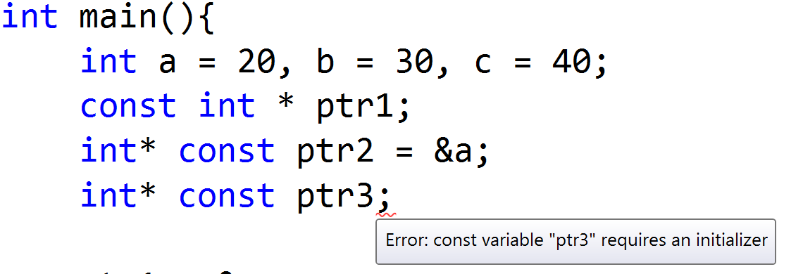
Pointer and const Common mistakes
Ptr3: is a constant pointer but it is not initialized likes pointer ptr2

Slide 43
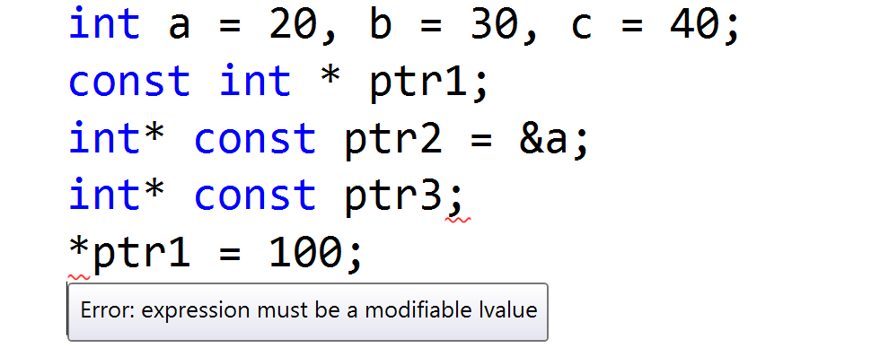
Pointer and const Common mistakes
The value that ptr1 points to cannot be changed via *ptr1.
Therefore, it cannot be on the left of the assignment expression

Slide 44
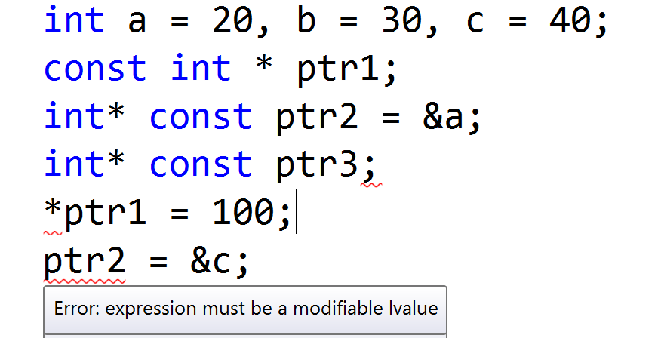
Pointer and const Common mistakes
Pointer ptr2 is a constant and is initialized when it is created
Then, it cannot make ptr2 point to any other object

Slide 45
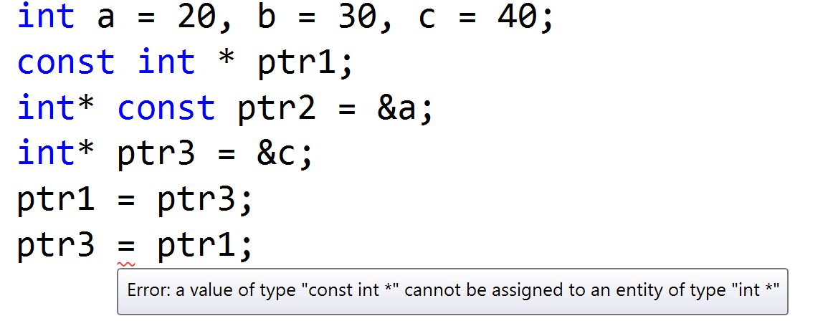
Pointer and const Common mistakes
ptr3: is a pointer, can be changed or change the value it points to
Assign pointer ptr1 to ptr3: makes the value that ptr1 points to changeable
→ This is not allowed by compiler
Because if it allows, the ptr1 is meaningless.
Programmers can always change the content that ptr1 points to by using temporary pointer.

Slide 46
Pointer and const Common mistakes
-> OK
-> ERROR
ptr3: is a pointer, can be changed or change the value it points to
Assign pointer ptr1 to ptr3: makes the value that ptr1 points to changeable
→ This is not allowed by compiler
Because if it allows, the ptr1 is meaningless.
Programmers can always change the content that ptr1 points to by using temporary pointer.

Slide 47
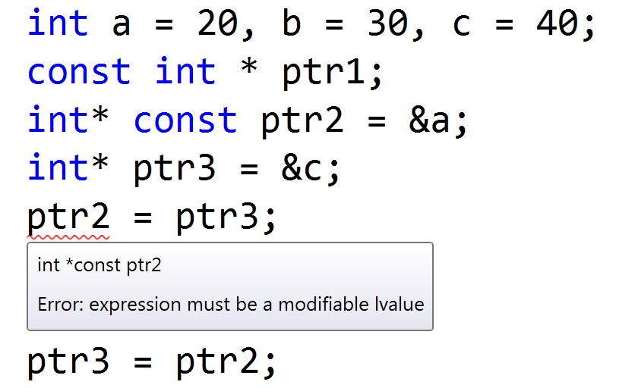
Pointer and const Common mistakes
-> ERROR
-> OK
ptr2: can not be changed

Slide 48
Pointer to pointer
int x;
int* px = &x;
int** ppx = &px;
int*** ppx = &ppx;

Slide 49
Pointer to pointer
int x;
10
x = 10;
int* px = &x;
*px = 10;
int** ppx = &px;
**ppx = 10;
int*** ppx = &ppx;
***pppx = 10;

Slide 50
Void pointer
void *ptr: is pointer with undefined data type
Can be cast to any desired data type
Gives programs a great flexibility
But it has risks: the compiler cannot check data type compatibility at compile time

Slide 51
Exercise
Re-implement all exercises related to array, but all data must be stored in HEAP memory

